Slide 1
BCSE103E- Computer Programming: JAVA
Module 7 : Java Collection Frameworks
Dr. S.A. Amutha Jeevakumari Assistant Professor
School of Computer Science and Engineering VIT - Chennai

Slide 2

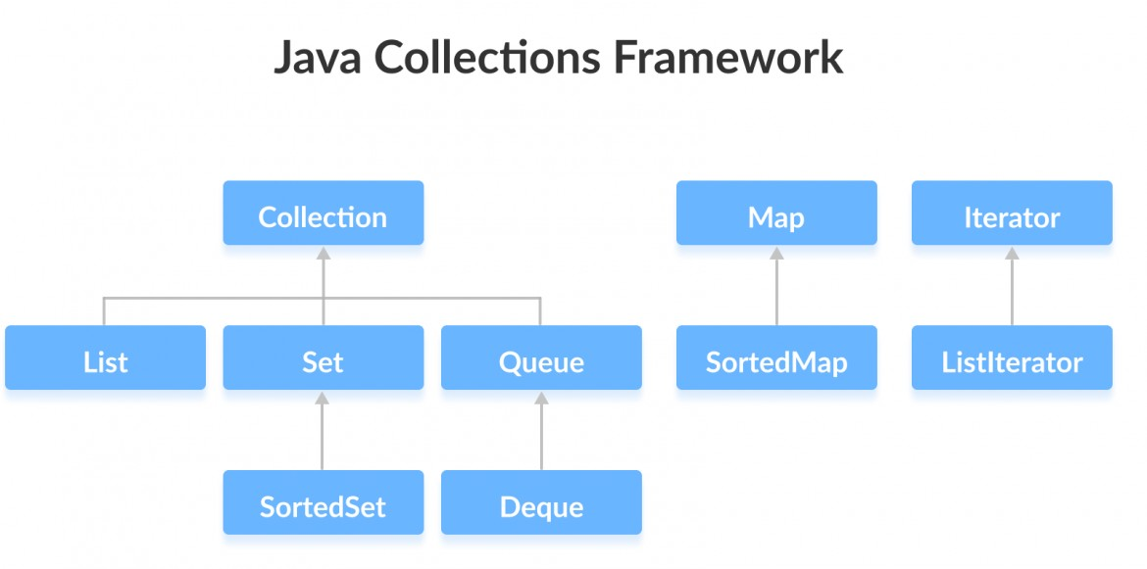
Java Collection Framework
The java.util package contains all the classes and interfaces for the Collection framework.
JCF
It is the root interface of the collections framework hierarchy.
Java does not provide direct implementations of the Collection interface but provides implementations of its subinterfaces like List, Set, and Queue

Slide 3
Collections Framework Vs. Collection Interface
Java Collection interface is the root interface of the collections framework. The Java Collection framework includes other interfaces as well: Map and
Iterator. And may also have subinterfaces.
Subinterfaces of the Collection Interface:
List Interface : is an ordered collection that allows us to add and remove elements like an array.
Set Interface : allows us to store elements in different sets similar to the set in mathematics. It cannot have duplicate elements.
Queue Interface : is used when we want to store and access elements in First In, First Out manner
Java Map Interface : allows elements to be stored in key/value pairs. Keys are unique names that can be used to access a particular element in a map. And, each Key has a single Value associated with it.
Java Iterator Interface : provides methods that can be used to access elements of collections

Slide 4
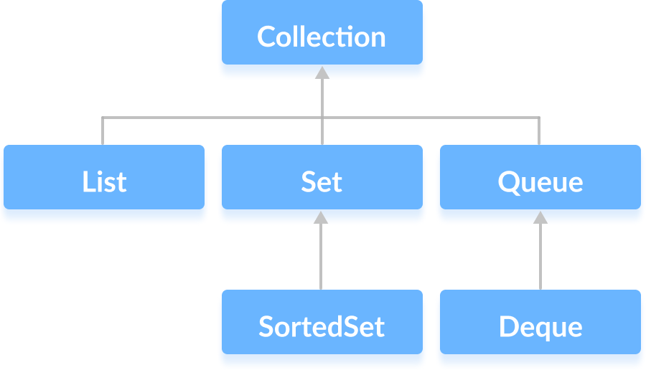
Java Collection Interface
The Collection interface is the root interface of the Java collections framework.
Methods of Collection : includes various methods that can be used to perform
different operations on objects.
add() - inserts the specified element to the collection
size() - returns the size of the collection
remove() - removes the specified element from the collection
iterator() - returns an iterator to access elements of the collection
addAll() - adds all the elements of a specified collection to the collection
removeAll() - removes all the elements of the specified collection
from the collection
clear() - removes all the elements of the collection

Slide 5
Methods of Collection interface I
public boolean add(E e) : is used to insert an element in collection.
public boolean addAll(Collection<? extends E> c) : is used to insert the specified collection elements in the invoking collection.
public boolean remove(Object element) : used to delete an element.
public boolean removeAll(Collection<?> c) : used to delete all elements of the specified collection from the invoking collection.
default boolean removeIf(Predicate<? super E> filter) : is used to delete all the elements of the collection that satisfy the specified predicate.
public boolean retainAll(Collection<?> c) : It is used to delete all the elements of invoking collection except the specified collection.
public int size() : returns the total no. of elements in the collection.
public void clear() : removes all elements from the collection.
public boolean contains(Object element) : used to search an element.
public boolean containsAll(Collection<?> c):
It is used to search the specified collection in the collection.

Slide 6
Methods of Collection interface II
public Iterator iterator() : It returns an iterator.
public Object[] toArray() : It converts collection into array.
public <T> T[] toArray(T[] a) : It converts collection into array. Here the runtime type of the returned array is that of the specified array.
public boolean isEmpty() : It checks if collection is empty.
default Stream<E> parallelStream() :
It returns a possibly parallel Stream with the collection as its source.
default Stream<E> stream() : It returns a sequential Stream with the collection as its source.
default Spliterator<E> spliterator() :
It generates a Spliterator over the specified elements in the collection.
public boolean equals(Object element) : It matches two collections.
public int hashCode() : It returns the hash code number of the collection.

Slide 7
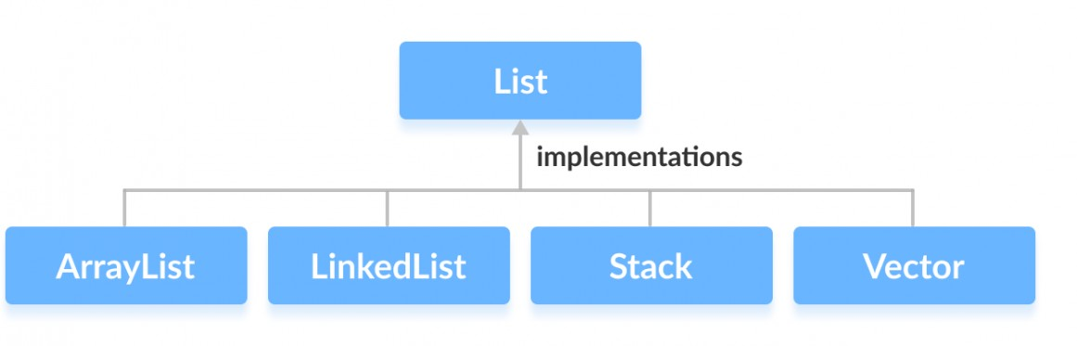
Java List Interface... I
List Interface
It is an ordered collection that allows us to store and access elements sequentially. And extends the Collection interface. Classes that Implement List :
How to use List? : We must import java.util.List package in order to use List.
// ArrayList implementation of List
List<String> list1 = new ArrayList<>();
// LinkedList implementation of List
List<String> list2 = new LinkedList<>();

Slide 8
Java List Interface... II
Methods of List :
add() - adds an element to a list
addAll() - adds all elements of one list to another
get() - helps to randomly access elements from lists
iterator() - returns iterator object that can be used to sequentially access elements of lists
set() - changes elements of lists
remove() - removes an element from the list
removeAll() - removes all the elements from the list
clear() - removes all the elements from the list (efficient than removeAll())
size() - returns the length of lists
toArray() - converts a list into an array
contains() - returns true if a list contains specified element

Slide 9
Example-1 : Implementation of ArrayList I
The ArrayList class of the Java collections framework provides the functionality of resizable-arrays.
import java.util.List; import java.util.ArrayList; class ArrayLIST {
public static void main(String[] args) {
// Creating list using the ArrayList class List<Integer> MyList = new ArrayList<>(); List<Integer> MyList1 = new ArrayList<>();
MyList1.add(10); MyList1.add(20); // adding Elements into MyList-1
// Add elements to the list
MyList.add(1); MyList.add(5); MyList.add(3); MyList.add(7); MyList.addAll(2,MyList1); // Adding Elements from MyList-1 System.out.println("List: " + MyList); System.out.println("IndexOf : " + MyList.indexOf(10));
// Access element from the list
System.out.println("Accessed Element: " + MyList.get(2));
// Remove element from the list
System.out.println("Removed Element: " + MyList.remove(1)); System.out.println("Accessed Element: " + MyList.set(3, 30)); System.out.println("Size of MyList : " + MyList.size()); System.out.println("Is 10 Exists in the List : " + MyList.contains(10)); MyList.sort(null); // Sort Ascending Order;

Slide 10
Example-1 : Implementation of ArrayList II
System.out.println("Sort List: " + MyList); System.out.println("Is List Empty : " + MyList.isEmpty()); MyList.clear();
System.out.println("Is List Empty : " + MyList.isEmpty());
}
}
/*
List: [1, 5, 10, 20, 3, 7]
IndexOf : 2
Accessed Element: 10
Removed Element: 5
Accessed Element: 3 Size of MyList : 5
Is 10 Exists in the List : true
Sort List: [1, 7, 10, 20, 30]
Is List Empty : false Is List Empty : true
*/

Slide 11
Java Vector I
The Vector class is an implementation of the List interface that allows us to create resizable-arrays similar to the ArrayList class.
Java Vector vs. ArrayList :
The Vector class synchronizes each individual operation. This means whenever we want to perform some operation on vectors, the Vector class automatically applies a lock to that operation.
In ArrayList, methods are not synchronized. Instead, it uses the
Collections.synchronizedList() method that synchronizes the list as a whole.
Creating a Vector :
import java.util.Vector;
Vector<Type> vector = new Vector<>();
Example :
Vector<Integer> vector= new Vector<>(); Vector<String> vector= new Vector<>();

Slide 12
Java Vector II
Methods of Vector :
add(element) - adds an element to vectors
add(index, element) - adds an element to the specified position
addAll(vector) - adds all elements of a vector to another vector
get(index) - returns an element specified by the index
iterator() - returns an iterator object to sequentially access vector elements
remove(index) - removes an element from specified position
removeAll() - removes all the elements
clear() - removes all elements. It is more efficient than removeAll()
set() - changes an element of the vector
size() - returns the size of the vector
toArray() - converts the vector into an array

Slide 13
Java Vector III
toString() - converts the vector into a String
contains() - searches the vector for specified element and returns a boolean result
import java.util.Vector; class JavaVectorClass {
public static void main(String[] args) { Vector<String> animals= new Vector<>(); animals.add("Dog"); animals.add("Horse"); animals.add("Pig"); animals.add("Cat"); System.out.println("Befor Sort Vector: " + animals);
animals.sort(null); // Sort Animals
System.out.println("After Sort Vector: " + animals); String element = animals.remove(1); // Using remove() System.out.println("Removed Element: " + element); animals.add("Donkey");
System.out.println("After Element Removed: " + animals);
System.out.println("Indext of Pig: " + animals.indexOf("Pig")); System.out.println("Check Horse : " + animals.contains("Horse")); System.out.println("Check Parrot : " + animals.contains("Parrot")); animals.add("Cow");

Slide 14
Java Vector IV
System.out.println("Check Size : " + animals.size()); animals.set(3, "Dog");
System.out.println("After Set Vector: " + animals);
animals.clear(); // Using clear()
System.out.println("Vector after clear(): " + animals); System.out.println("Check Empty or Not : " + animals.isEmpty());
}
}
/*
Befor Sort Vector: [Dog, Horse, Pig, Cat] After Sort Vector: [Cat, Dog, Horse, Pig] Removed Element: Dog
After Element Removed: [Cat, Horse, Pig, Donkey]
Indext of Pig: 2 Check Horse : true Check Parrot : false Check Size : 5
After Set Vector: [Cat, Horse, Pig, Dog, Cow]
Vector after clear(): [] Check Empty or Not : true
*/

Slide 15
Java Stack I
The Stack class extends the Vector class.
In Stack, elements are stored and accessed in Last In First Out. i.e., elements are added/removed only at top of the stack.
Creating a Stack :
import java.util.Stack
Stack<Type> stacks = new Stack<>();
Examples:
Stack<Integer> stacks = new Stack<>(); Stack<String> stacks = new Stack<>();
Methods of Stack :
Since Stack extends the Vector class, it inherits all the methods Vector Other Methods
push() - To add an element to the top of the stack.
pop() - To remove an element from the top of the stack
peek() - returns an object from the top of the stack
search() - To search an element in the stack.
empty() - To check whether a stack is empty or not

Slide 16
Java Stack II
import java.util.Stack;
class JavaSTACK {
public static void main(String[] args) {
Stack<String> animals= new Stack<>();
// Stack Created
animals.push("Horse"); animals.push("Cat"); System.out.println("Stack: " + animals);
animals.add("Zibra");
animals.push("Dog");
System.out.println("Stack: " + animals); System.out.println("Peek Element : " + animals.peek()); System.out.println("Element Poped : " + animals.pop()); System.out.println("Search Dog : " + animals.search("Dog")); System.out.println("Search Dog : " + animals.contains("Dog"));
System.out.println("Is the stack empty? " + animals.empty()); animals.clear(); // Clear and Check for empty.
System.out.println("Is the stack empty? " + animals.isEmpty());
}
}

Slide 17
Java Stack III
/*
Stack: [Horse, Cat, Dog]
Stack: [Horse, Cat, Dog, Zibra] Peek Element : Zibra
Element Poped : Zibra
Search Dog : 1 Search Dog : true
Is the stack empty? false
Is the stack empty? true
*/

Slide 18
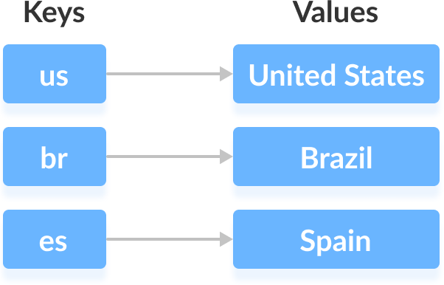
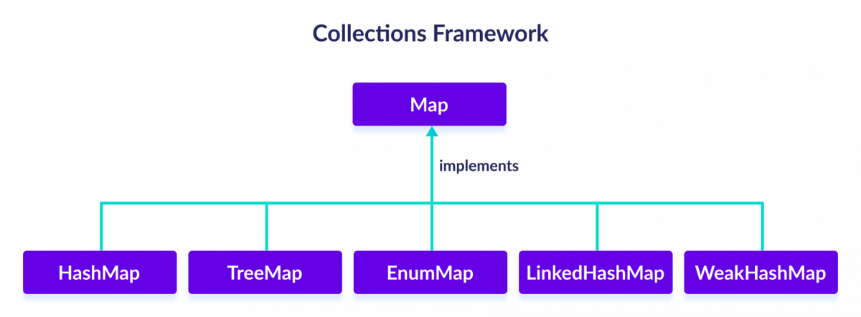
Java Map Interface I
It is of Java collections framework provides the functionality of the map
data structure.
Elements of Map are stored in key/value pairs. Keys are unique values associated with individual Values.
It cannot contain duplicate keys. And, each key is associated with a single value.

Slide 19
Java Map Interface II
Methods of Map :
put(K, V) - Inserts the both (K,V) into the map as Element. If the key is present, its value is replaced.
putAll() - Inserts all the entries from the specified map.
putIfAbsent(K, V) - Inserts the association if the ’K’
is not already associated with ’V’.
get(K) - Returns the value associated with ’K’.
If the key is not found, it returns null.
getOrDefault(K, defaultValue) - Returns the value associated with
the specified key ’K’. If the key is not found, it returns the defaultValue.
containsKey(K) - Checks if ’K’ is present in the map or not.
containsValue(V) - Checks if ’V’ is present in the map or not.
replace(K, V) - Replace the value ’K’ with the new ’V’.
replace(K, oldValue, newValue) - Replaces the value of the ’K’ with he new ’V’ only if the ’K’ is associated with ’V’.

Slide 20
Java Map Interface III
remove(K) - Removes the entry from the map represented by ’K’.
remove(K, V) - Removes the entry from the map that has ’K’ with ’V’.
keySet() - Returns a set of all the Key’s present in a map.
values() - Returns a set of all the Values present in a map.
entrySet() - Returns a set of all the ’K’/’V’ mapping in a map.
import java.util.Map; import java.util.HashMap; class HashMAP {
public static void main(String[] args) {
// Creating a map using the HashMap
Map<String, Integer> numbers = new HashMap<>(); numbers.put("One", 1); numbers.put("Two", 2);
numbers.putIfAbsent("Three", 3);
System.out.println("Map: " + numbers); System.out.println("Keys: " + numbers.keySet()); System.out.println("Values: " + numbers.values()); System.out.println("Entries: " + numbers.entrySet());
System.out.println("Get the Value at K :" + numbers.get("Two"));
System.out.println("Contains K :" + numbers.containsKey("Two"));

Slide 21
Java Map Interface IV
System.out.println("Contains K :" + numbers.containsValue(4)); numbers.replace("Two", 20);
System.out.println("After Replace Map Entries are : " + numbers);
numbers.replace("Two", 20, 2);
System.out.println("After Replace Map Entries are : " + numbers); System.out.println("Removed Value: " + numbers.remove("Two");
}
}
/*
Map: {One=1, Two=2, Three=3} Keys: [One, Two, Three] Values: [1, 2, 3]
Entries: [One=1, Two=2, Three=3]
Get the Value at K :2 Contains K :true Contains K :false
After Replace Map Entries are : {One=1, Two=20, Three=3}
After Replace Map Entries are : {One=1, Two=2, Three=3} Removed Value: 2
*/

Slide 22
Practice the Following...!
Java LinkedHashMap Java WeakHashMap Java EnumMap
Java SortedMap Interface Java NavigableMap Interface Java TreeMap
Java ConcurrentMap Interface Java ConcurrentHashMap
The Above Data Structure have some additional Methods other than MAP

Slide 23
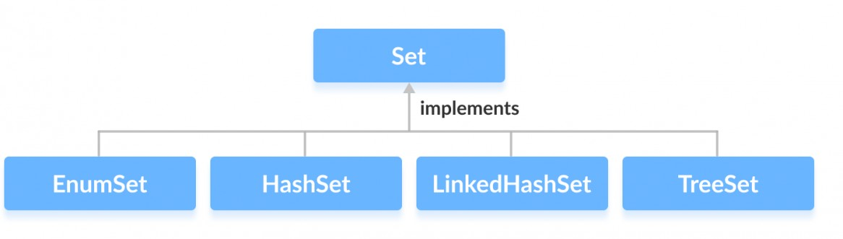
Java Set Interface... I
It is of Java Collections framework provides the features of the mathematical set in Java. And extends the Collection interface. Unlike the List interface, Sets cannot contain duplicate elements.
The Following Classes uses the functionalities of Set Interface
Methods of Set Interface :
add() - adds the specified element to the set
addAll() - adds all the elements of the specified collection to the set
iterator() - returns an iterator that can be used to access elements of the set sequentially
remove() - removes the specified element from the set
removeAll() - removes all the elements from the set.

Slide 24
Java Set Interface... II
retainAll() - retains all the elements in the set that are also present in another specified set
clear() - removes all the elements from the set
size() - returns the length (number of elements) of the set
toArray() - returns an array containing all the elements of the set
contains() - returns true if the set contains the specified element
containsAll() - returns true if the set contains all the elements of the specified collection
hashCode() - returns a hash code value
(address of the element in the set)

Slide 25
Java Set Interface... III
Set Operations :
Union - to get the union of two sets x and y, we can use x.addAll(y)
Intersection - to get the intersection of two sets x and y, we can use x.retainAll(y)
Subset - to check if x is a subset of y, we can use y.containsAll(x)
import java.util.Set; import java.util.HashSet; class HashSET {
public static void main(String[] args) {
// Creating a set using the HashSet class
Set<Integer> set1 = new HashSet<>();
// Add elements to the set1 set1.add(2); set1.add(3); System.out.println("Set1: " + set1);
// Creating another set using the HashSet class
Set<Integer> set2 = new HashSet<>();

Slide 26
Java Set Interface... IV
// Add elements
set2.add(1); set2.add(2); System.out.println("Set2: " + set2);
// Set2 Intersection Set1
set2.retainAll(set1); System.out.println("Intersection of : " + set2);
// Set2 Union Set1
set2.addAll(set1); System.out.println("Union is: " + set2);
System.out.println("Subset of :"+ set1.containsAll(set2));
}
}
/*
Set1: [2, 3]
Set2: [1, 2]
Intersection of : [2] Union is: [2, 3] Subset of :true
*/

Slide 27
Java Algorithms
The Java collections framework provides various algorithms that can be used to manipulate elements stored in data structures.
Algorithms in Java are static methods that can be used to perform various operations on collections.
Algorithms are generic in nature (i.e., Can apply on any Collections).
sort() : is used to sort elements.
shuffle() : is used to destroy, the order present in Data Strucutre. It does just the opposite of the sorting.
reverse() : reverses the order of elements
fill() : replace every element with the specified value
copy() : creates a copy of elements from the source to destination
swap() : swaps the position of two elements in a collection
addAll() : adds all the elements of a collection to other collection
binarySearch() : searches for the specified element and its position.
frequency() : returns the count an element present in collection.
disjoint() : checks if two collections contain some common element
min() : are used to find the minimum element.
max() : are used to find the maximum element.

Slide 28
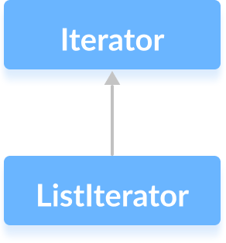
Methods of Iterator interface I
Iterator interface provides the facility of iterating the elements in a forward direction only.
It allows us to access elements of a collection. It has a subinterface
ListIterator.
Methods of Iterator:
hasNext() : returns true if the iterator has more elements otherwise it returns false.
next() : returns the element and moves the cursor pointer
to the next element.
remove() : removes the last elements returned by the iterator.
forEachRemaining() : performs the specified action for each remaining element of the collection

Slide 29
Java ListItItperroavtiodersInthteerffuanccetioInality to access(bidirectional) elements of a list.
Methods of ListIterator:
hasNext() : returns true if there exists an element in the list
next() : returns the next element of the list
nextIndex() : returns the index of the element that the next() method will return
previous() : returns the previous element of the list
previousIndex() : returns the index of the element that the
previous() method will return
remove() : removes the element returned by either next() or previous()
set() : replaces the element returned by either next() or previous()
with the specified element
import java.util.ArrayList; import java.util.ListIterator; class LISTIterator {
public static void main(String[] args) {
// Creating an ArrayList
ArrayList<Integer> numbers = new ArrayList<>(); numbers.add(1); numbers.add(3); numbers.add(2); System.out.println("ArrayList: " + numbers);
// Creating an instance of ListIterator
ListIterator<Integer> iterate = numbers.listIterator();

Slide 30
Java ListIterator Interface II
// Using the next() method
System.out.println("Next Element: " + iterate.next());
// Using the nextIndex()
System.out.println("Position of Next Element: " + iterate.nextIndex());
// Using the hasNext() method
System.out.println("Is there any next element? " + iterate.hasNext());
System.out.println("Previous Element: " + iterate.previous());
// Using the previousIndex()
System.out.println("Position of the Previous element: " + iterate.previ
}
}
/*
ArrayList: [1, 3, 2]
Next Element: 1
Position of Next Element: 1
Is there any next element? true Previous Element: 1
Position of the Previous element: -1
*/

Slide 31
Java Serialization and DeSerialization
Serialization is a process of writing the state of an object into a byte-stream.
It is mainly used in Hibernate, RMI, JPA, EJB and For serializing the object, we call the writeObject() method ObjectOutputStream, and for deserialization we call the readObject() method of ObjectInputStream class. technologies.
It is a mechanism to convert an object into stream of bytes so that it can be written into a file, transported through a network or stored into database.
De-serialization is just a vice versa.
Or
Serialization is converting an object to stream of bytes and
De-serialization is rebuilding the object from stream of bytes.
A class must implement java.io.Serializable interface to be eligible for serialization.
Serializing the object done, by calling writeObject() method ObjectOutputStream, and
Deserialization we call the readObject() method of ObjectInputStream class.

Slide 32
Example - Serialization and DeSerialization I
// Student.java;
public class Student implements java.io.Serializable{
private int stuRollNum, stuAge;
private String stuName;
private transient String stuAddress;
private transient int stuHeight;
public Student(int roll, int age, String name, String address, int height){
this.stuRollNum = roll; this.stuAge = age; this.stuName = name; this.stuAddress = address; this.stuHeight = height;
}
public int getStuRollNum() { return stuRollNum; }
public int getStuAge() { return stuAge; }
public String getStuName() { return stuName; } public String getStuAddress() { return stuAddress; } public int getStuHeight() { return stuHeight; }
}
// StudentSerialization.java
import java.io.FileOutputStream; import java.io.ObjectOutputStream; import java.io.IOException;

Slide 33
Example - Serialization and DeSerialization II
public class StudentSerialization {
public static void main(String args[]) {
Student obj = new Student(50396, 31, "Pradeep K V", "Chennai", 6);
try{
FileOutputStream fos = new FileOutputStream("Student.ser"); ObjectOutputStream oos = new ObjectOutputStream(fos); oos.writeObject(obj);
oos.close(); fos.close();
System.out.println("Serialization Done!!");
}catch(IOException ioe){ System.out.println(ioe); }
}
}
/* Serialization Done!! */
// StudentDeSerialization.java
import java.io.FileInputStream; import java.io.ObjectInputStream; import java.io.IOException;
public class StudentDeSerialization {
public static void main(String args[]) { Student o=null;

Slide 34
Example - Serialization and DeSerialization III
try{
FileInputStream fis = new FileInputStream("Student.ser"); ObjectInputStream ois = new ObjectInputStream(fis);
o = (Student)ois.readObject(); ois.close(); fis.close();
}
catch(IOException ioe) { ioe.printStackTrace(); return; }
catch(ClassNotFoundException cnfe) { System.out.println("Student Class is not found."); cnfe.printStackTrace(); return;
}
System.out.println("Student Name:"+o.getStuName()); System.out.println("Student Age:"+o.getStuAge()); System.out.println("Student Roll No:"+o.getStuRollNum()); System.out.println("Student Address:"+o.getStuAddress()); System.out.println("Student Height:"+o.getStuHeight());
}
}
/*
Student Name:Pradeep K V Student Age:31
Student Roll No:50396
Student Address:null Student Height:0
*/

Slide 35
Java Transient Keyword I
Java transient keyword is used in serialization. If you define any data member as transient, it will not be serialized.
Example : In a class as Student, it has three data members id, name and age. If you serialize the object, all the values will be serialized but don’t want to serialize one value, e.g. Age then we can declare the age data
member as transient.
import java.io.*;
class Emp implements Serializable {
private static final long serialversionUID = 50396L;
transient int a; static int b; String name; int age;
// Default constructor
public Emp(String name, int age, int a, int b) {
this.name = name; this.age = age; this.a = a;
}
}
this.b = b;

Slide 36
Java Transient Keyword II
public class Serial_DeSerial_Test {
public static void printdata(Emp object1) { System.out.println("name = " + object1.name); System.out.println("age = " + object1.age); System.out.println("a = " + object1.a); System.out.println("b = " + object1.b);
}
public static void main(String[] args) {
Emp object = new Emp("Pradeep K V", 30, 2, 1000); String filename = "KVP.txt";
// Serialization
try { // Saving of object in a file
FileOutputStream file = new FileOutputStream(filename); ObjectOutputStream out = new ObjectOutputStream(file);
// Method for serialization of object
out.writeObject(object); out.close(); file.close();
System.out.println("Object has been serialized Data \n"
+ "before Deserialization.");
printdata(object);
object.b = 2000; // value of static variable changed
}
catch (IOException ex) { System.out.println("IOException is caught");

Slide 37
Java Transient Keyword III
object = null;
// Deserialization
try { // Reading the object from a file FileInputStream file = new FileInputStream(filename); ObjectInputStream in = new ObjectInputStream(file);
// Method for deserialization of object
object = (Emp)in.readObject(); in.close(); file.close();
System.out.println("Object has been deserialized Data \n"
+ " after Deserialization.");
printdata(object);
}
catch (IOException ex) { System.out.println("IOException is caught");
catch (ClassNotFoundException ex) { System.out.println("ClassNotFoundException is caught");
}
} /*
}
Object has been serialized Data before Deserialization. name = Pradeep K V
age = 30, a = 2, b = 1000
Object has been deserialized Data after Deserialization. name = Pradeep K V
age = 30, a = 0, b = 2000
*/

Slide 38

Thanks

